Slide 1
Final Presentation
SkillSpotter: Mining and Categorizing Skills from Job Descriptions using NER
Kabir Thakur Pankaj Yadav

Slide 2
Overview
1
Objective Overview
2
Methodology
3
Model Results
4
Model Inference
5
Conclusion
6
Use Case
7
Ethical Concerns
Notes:
Objective overview
Methodology
Model
Results
Model Inference
Conclusion
Use Case
Ethical Concerns

Slide 3
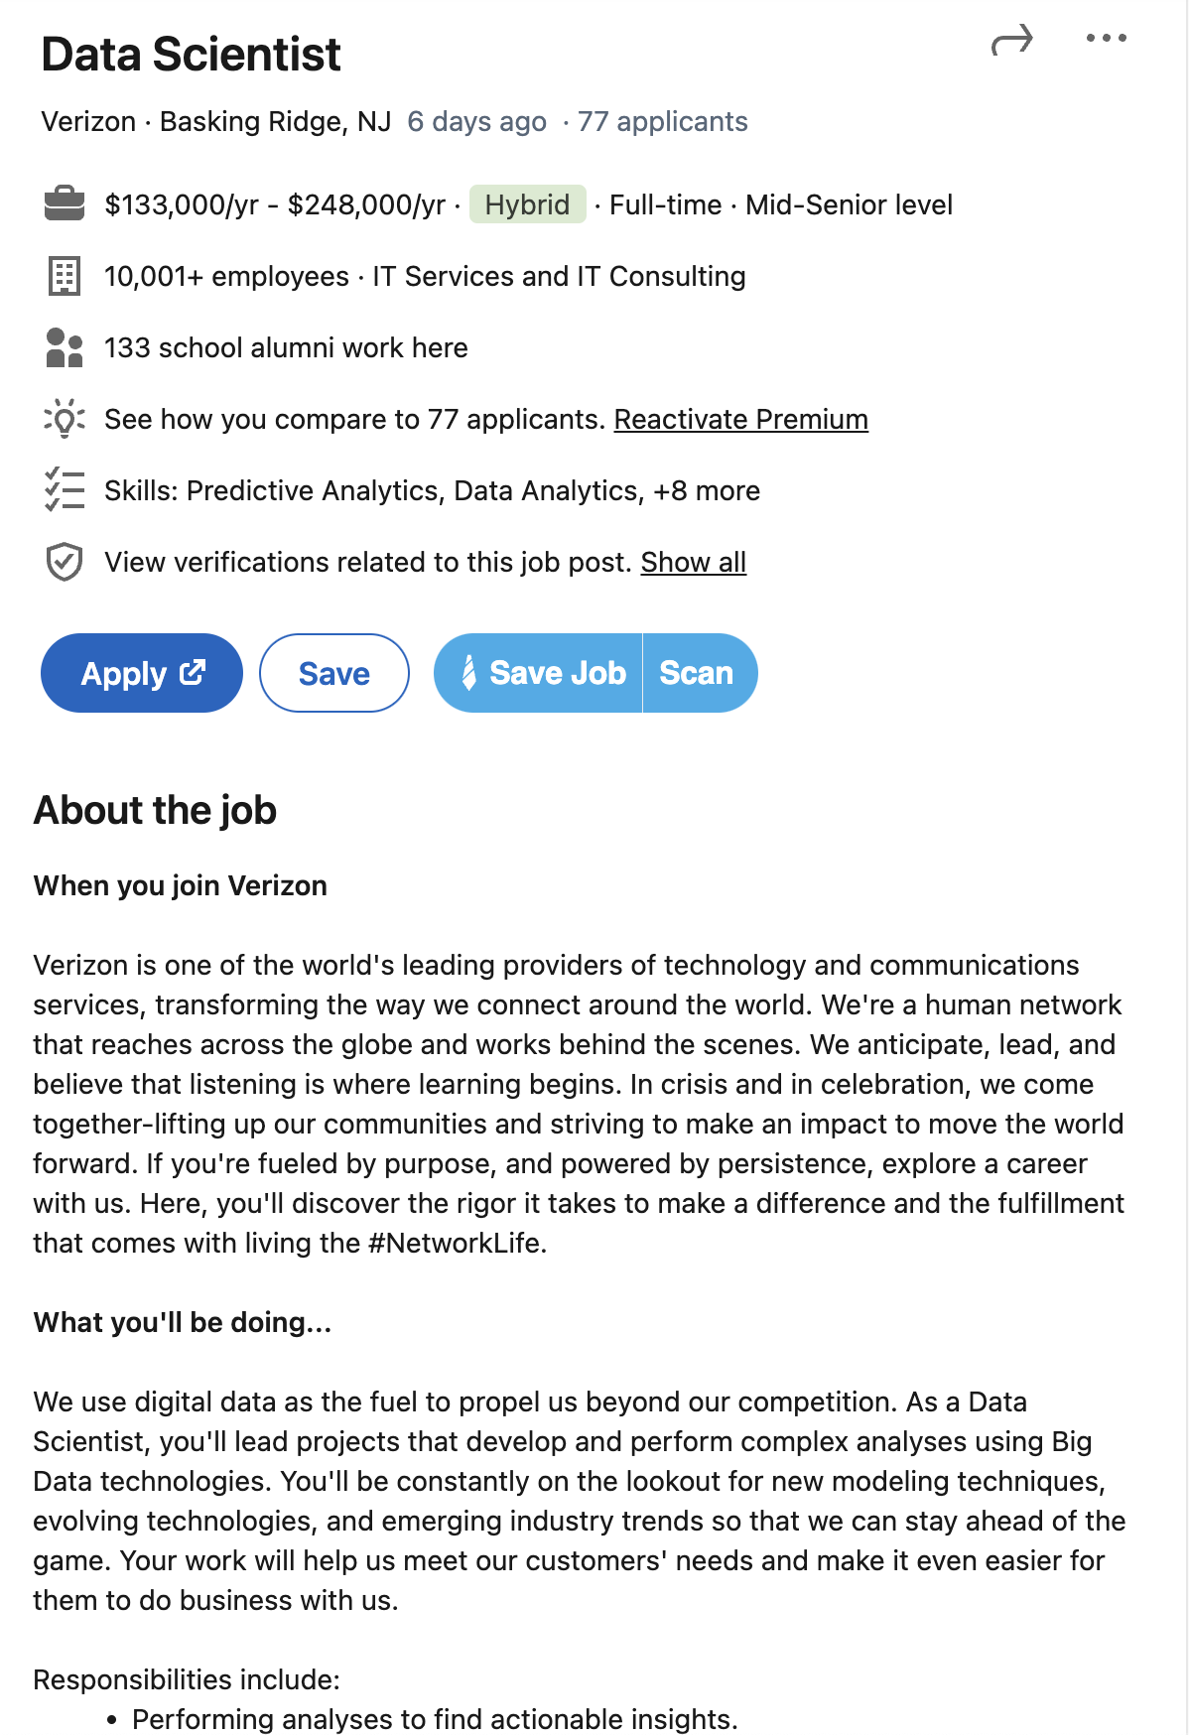







Objective Overview
Job Description
Pipeline
Pipeline
Skills to have
accounting | microsoft applications
big data | microsoft office
business analysis | predictive analytics
data analytics | programming languages
data warehousing | python
digital data | r
drawing | scan
excel | science
executive management | statistical analysis
google | tableau
impact | telecommunications
it | teradata
java | verizon
mathematics

Slide 4
Methodology
Data gathering
Web-scraped Job Description and master list for skills.
2. Data Cleaning
Cleaning the data by removing html tags, null values.
3. Data Sampling
Sampling only the relevant data form manually selected list of 34 job titles.
4. Data Transformation
Tokenization, BIO Tagging, flattening the data before using Data Collator to create tensors for model training.
5. Model Training & Evaluation
Used a Distilbert-base-uncased model with an 80-20 split for model training and got over 98% accuracy.
6. Model Inference
Inferenced our model over sample sentences to test and evaluate the model.
7. Final Use Case (Skills)
Model can be used to find similarity scores between resume and job description and thus be used as a recommendation model.

Slide 5
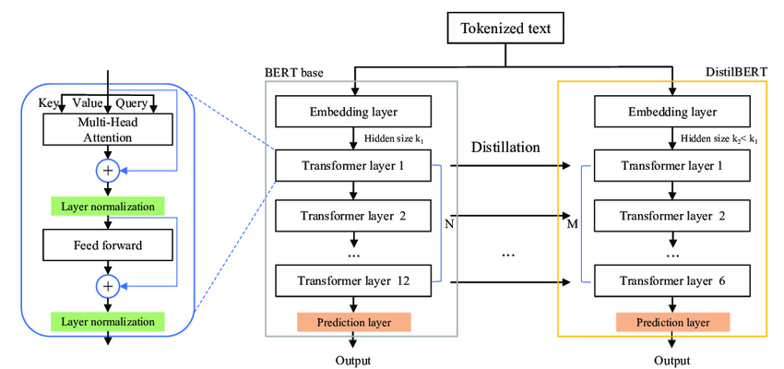
MODEL
Source : Adel, Hadeer, et al. "Improving crisis events detection using distilbert with hunger games search algorithm." Mathematics 10.3 (2022): 447.
ARCHITECTURE
Tokenizer: distilbert-base-uncased
Vocabulary Size : 30522
Maximum Positional Embeddings : 512
Tokenizer
Hyperparameters
Epochs : 3
Learning Rate : 0.00002
Weight Decay : 0.01

Slide 6
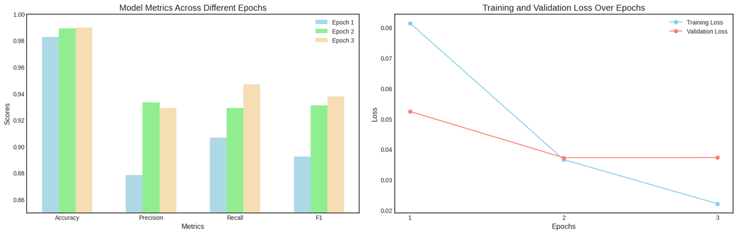
Results
Epoch | Training Loss | Validation Loss | Precision | Recall | F1 | Accuracy
1 | 0.081500 | 0.052436 | 0.878380 | 0.906783 | 0.892356 | 0.982703
2 | 0.036600 | 0.037228 | 0.933150 | 0.929218 | 0.931180 | 0.989165
3 | 0.022100 | 0.037300 | 0.929096 | 0.946809 | 0.937868 | 0.989842

Slide 7

Insights from model inference
The model was able to identify some abbreviated skills but not all. Example - identified JS as JavaScript but not ML as machine learning.
Identified 7/10 minor spelling mistakes in skills
Able to identify some skills not in master list like Teradata, Team Management, Continuous Learning etc.
Source : DALL-E 3
Prompt : "create a funny image about NLP model doing inference on job descriptions"
Notes:
We can try to use distilbert_base_cased model.

Slide 8
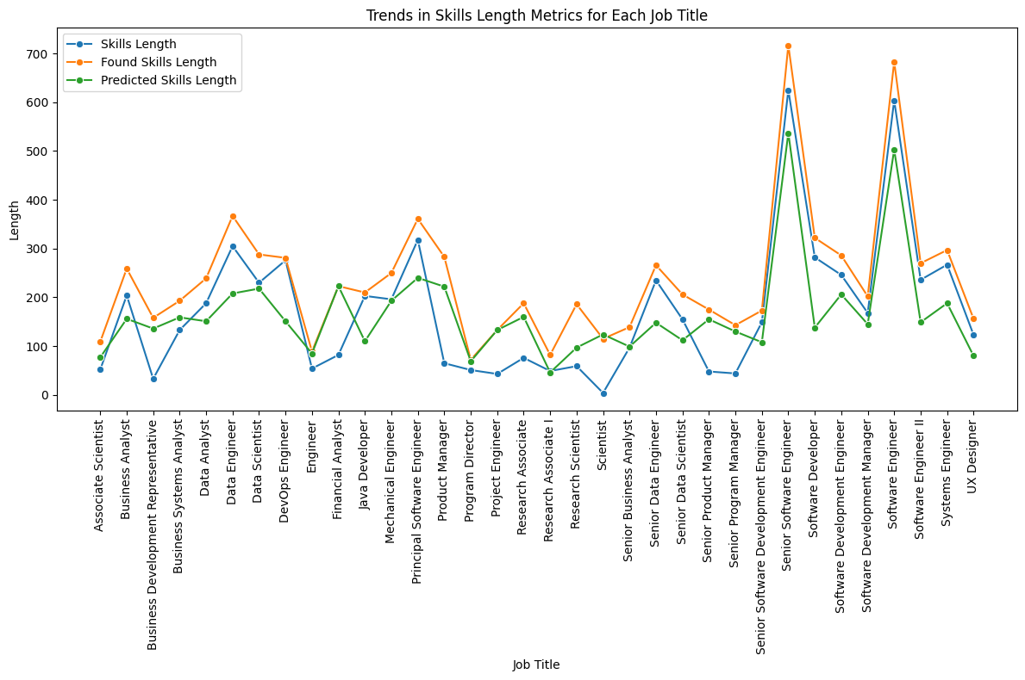
Found skills vs Skills
We can in general that we have found more skills than there were given explicitly in the job description through pattern matching to our master list.
Found skills vs Predicted skills​
In many of the categories there were less skills predicted than we found with pattern matching​.
This may be due to untuned parameters or misannotated words. Example 'auto' ​
Predicted skills vs Skills
We can see predicted skills are more than the explicitly mentioned skills in most categories​.
This means that our model is performing well, and we were able to extract more information about skills than mentioned explicitly in the job description.
Notes:
dfdfv

Slide 9
Conclusion
In conclusion the model performed well, but not as accurately as pattern matching.
The best technique would be to use a combination of both methods, pattern matching to find known skills and a model to keep the pattern matching list updated.
This model can be used to create a recommendation engine for Jobs or even to check how similar your resume is to the job description.

Slide 10
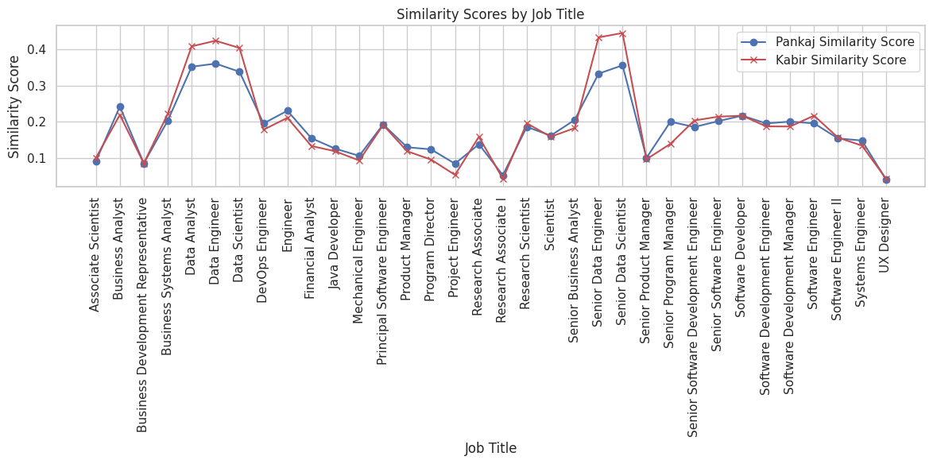
Use Case

Slide 11
Ethics Concerns
Ethical Use of Open-Source Data
This data is open source and scraped from the web. We ensure that the use of this data aligns with the terms set by the data providers. The data is being used for this academic project and this project would not be used for commercial purposes.
Over-reliance on Technology
Sole reliance on the NER model for screening candidates and job searching can be problematic. It's essential to have human oversight to interpret and contextualize the model’s findings, especially in complex and nuanced fields like human resources.
Data Imbalance
We have trained this model on a dataset which only contained Job Descriptions form companies in the US. We may be missing out on region specific skills if model is used to infer on a dataset with jobs from another geolocation. Similarly, we have trained the model to work with only tech specific roles and it may not work well for other roles.

Slide 12
Thank You

Slide 13
Appendix

Slide 14
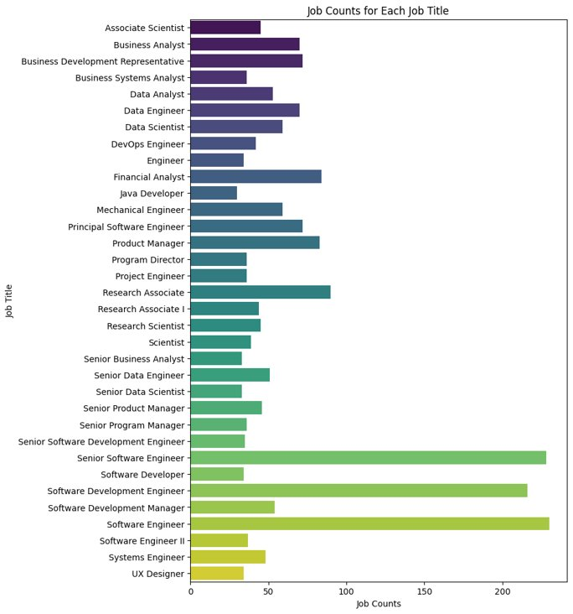
Data Imbalance

